Slide 1

Python Bytes - Week 6 Review and CYOA2

Slide 2

TABLE OF CONTENTS
01
Pop Quiz???
03
CYOA 2?
02
HW Check + Recap
03
CYOA 2
06

Slide 3
nah it was a joke
no pop quiz
long refresher!
can you find the 6 cats?

Slide 4
01
Quick? Refresher
1. What is a float?
A.
a data type of numbers with
16 bits of memory
B.
a data type of decimal point numbers
C.
a data type that is pre-defined and you can modify later on in code – a preset.
D.

Slide 5
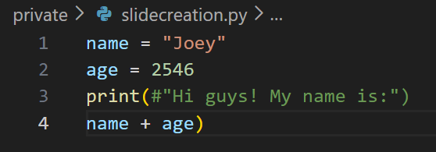
01
Refresher
2. What is the result? (Trick trick question)
A.
Hi guys! My name is:Joey2546
B.
TypeError
C.
Joey2546
D.
SyntaxError

Slide 6
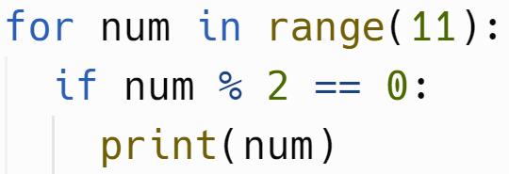
01
Long Refresher
3. What will be the output?
A.
‘0 2 4 6 8 10’
B.
‘0 1 2 3 4 5 6 7 8 9 10 11’
C.
‘2 4 6 8’
D.
‘2’

Slide 7
01
Refresher.
4. What is (2//4)**(8%6) + 2?
A.
6
B.
banana (idk?)
C.
2.25
D.
0

Slide 8
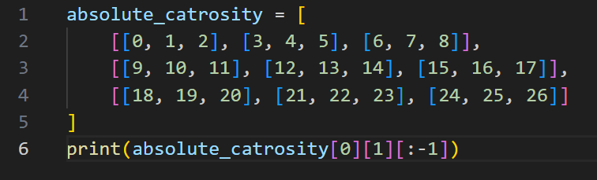
01
Quick Refresher
5. What number(s) are outputted?
A.
4
B.
5
C.
0, 1
D.
3, 4

Slide 9
01
Refreshments
6. What is the result? Hint: Alphabetical compare
A.
False
B.
True
C.
Frue
D.
Tralse

Slide 10

01
Quick Ranger
7. What will be the output? Let , mean new line
A.
3, 4, 4, 5
B.
1, 2, 2, 3
C.
8
D.
3

Slide 11

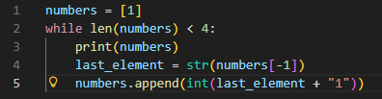



01
What?
8. What will be the output?
A.
B.
C.
D.

Slide 12
HW Check

Slide 13
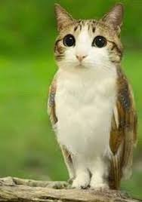
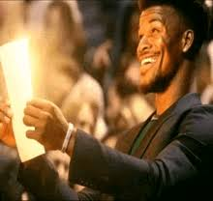
Those that do homework are very meowl

Slide 14
02
Last Week Recap
Functions

Slide 15
02
Last Week Recap
Functions
  Function = reusable block of code
  Function take input and give output !!!!!!
  Why not useless?
    Organization
    Recursion
    Many other uses!

Slide 16
02
Last Week Recap
parameter: things that are used in the function definition. they are basically variables that only exist in the function!
argument: what was pass into the function when we call it. E.g. print(“Hello”, “World”). In this case Hello and World are the arguments.
Pop Quiz!

Slide 17
02
Last Week Recapitulation
return: no pop quiz! Haha.
  this is the value you get and put in a variable when you call the function. In the function itself, when return is run, the function ends. Kind of like break!
*args:
  can pass an arbitrary amount of arguments. The parameter is a list.
on the homework…
  cool stuff! extensions!

Slide 18

02
Yesterweek Recapitulation
Default Parameter:
  This parameter takes on a default value if it is not passed as an argument.
Keyword Arguments:
  When you call a function and you assign a parameter name to the value you’re giving.

Slide 19
30
C.Y.O.A.2
Familiar?
Objective: Choose one… or both. The first one is easier.
  Remember the guessing game? Now let’s say you’re on a m*n sized board and there is a store somewhere random… You keep guess the coordinates and someone tells you if your guess is closer than the previous one or not.
  Create a to do list in python!

Slide 20
.03
C.Y.O.A.2
What coding should we use..? Anything we’ve learned :D (not everything)
  And maybe import time as needed.
What?
  print, input, variables, conditionals
  for loops, while loops
  functions 👻

Slide 21
Thats It!
please do your homework
please read slides
ples pls
github link

